Slide 1
Hospital Appointment

Slide 2


Team Information
Sandip Limbasiya - 92400527173

Slide 3
Problem Statement
Long waiting queues & repeated phone calls for booking
Paper registers / spreadsheets → lost records & double bookings
No real-time doctor availability check
Staff overloaded with manual coordination
No appointment status tracking (pending/approved/rejected)

Slide 4
Proposed Solution: Overview
Web-Based Platform: Online appointment booking accessible from any device with internet
Role-Based System: Two user roles -Admin (hospital staff) and Patient (general users)
Doctor Panel: Admin can Add/Edit/Delete doctors with specialization, fee, and availability

Slide 5
Objectives
• Appointment Booking
• User Authentication
• Doctor Management
• Status Management
• Responsive UI

Slide 6
Server Requirements
Software: XAMPP / Laragon- PHP Version: PHP 7.4+ or PHP 8.0+
Code Editor: VS Code
Version Control: GitHub

Slide 7
Technology Stack
Frontend: HTML5, CSS3, JavaScript
Backend: PHP
Database: MySQL
Tools: VS Code, phpMyAdmin

Slide 8
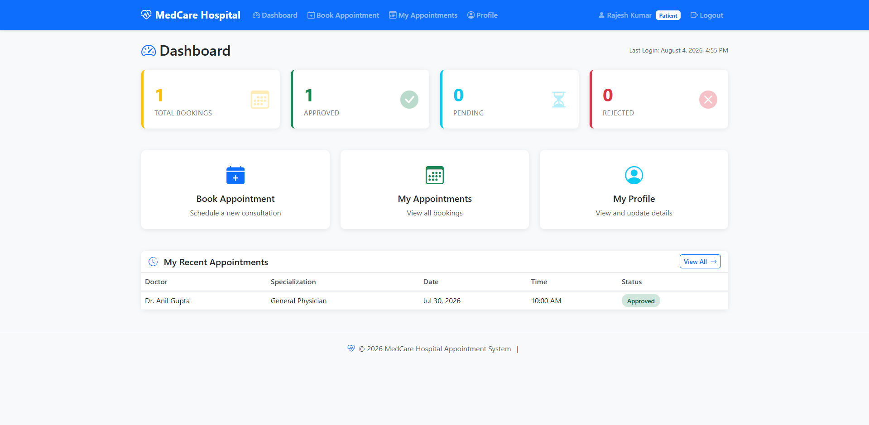
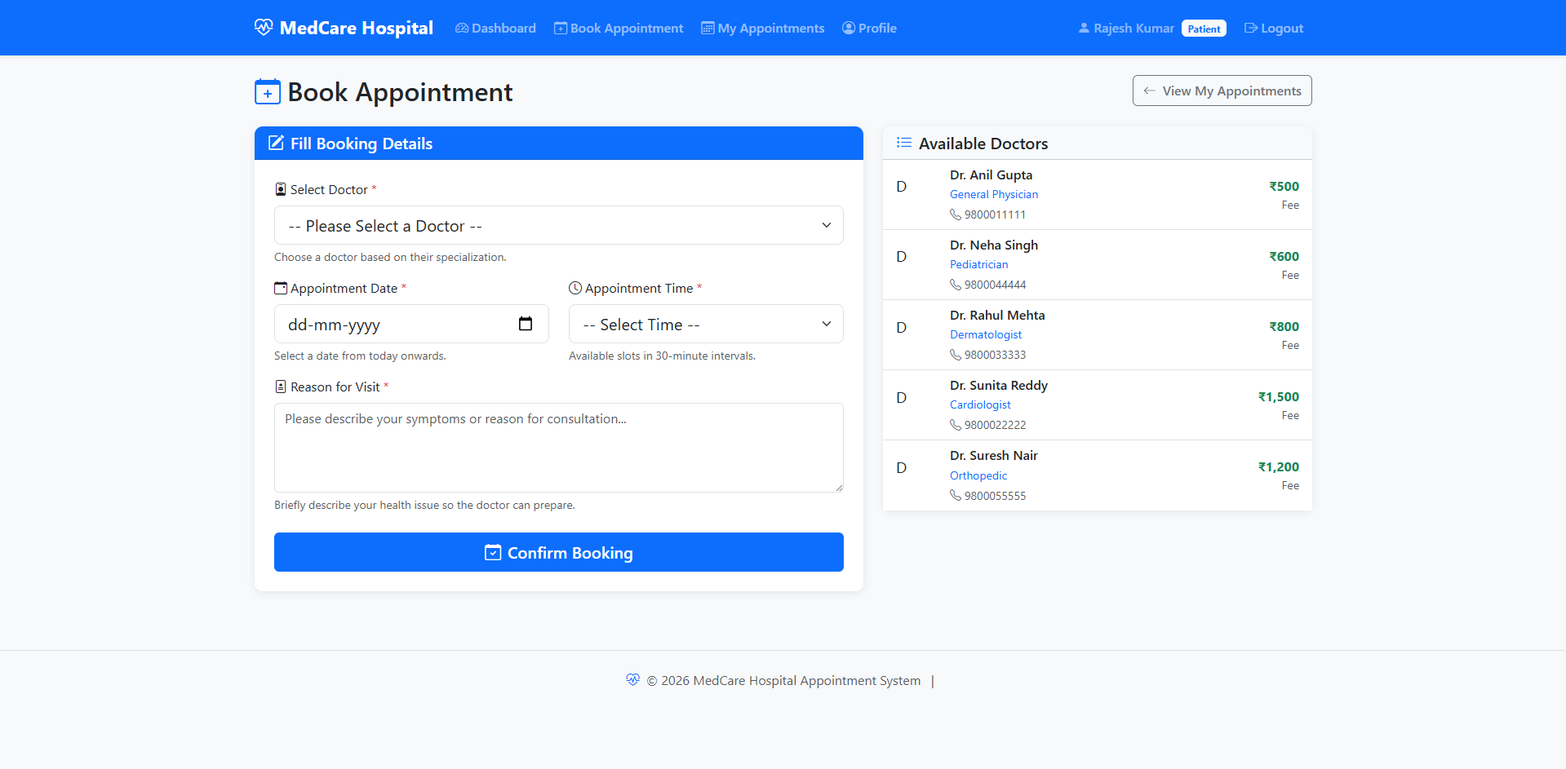
End User Interface
Responsive HTML5 interface with a clean and modern design.
Bootstrap 5 is used for a mobile-friendly and responsive layout.
Simple booking forms and user-friendly dashboards.

Slide 9
Admin Dashboard
Admin Dashboard to monitor overall system activity.
User Management - Manage user accounts and details.
Reports - View Appointment booking and system reports
CRUD - Create, Read, Update, and Delete records.

Slide 10
Database Design
Tables: Users, Doctors, Appointments
Primary & Foreign Keys: Each table has a unique ID as the Primary Key, User ID
Admin ID as an foreign key
Constraints: PRIMARY KEY, FOREIGN KEY

Slide 11
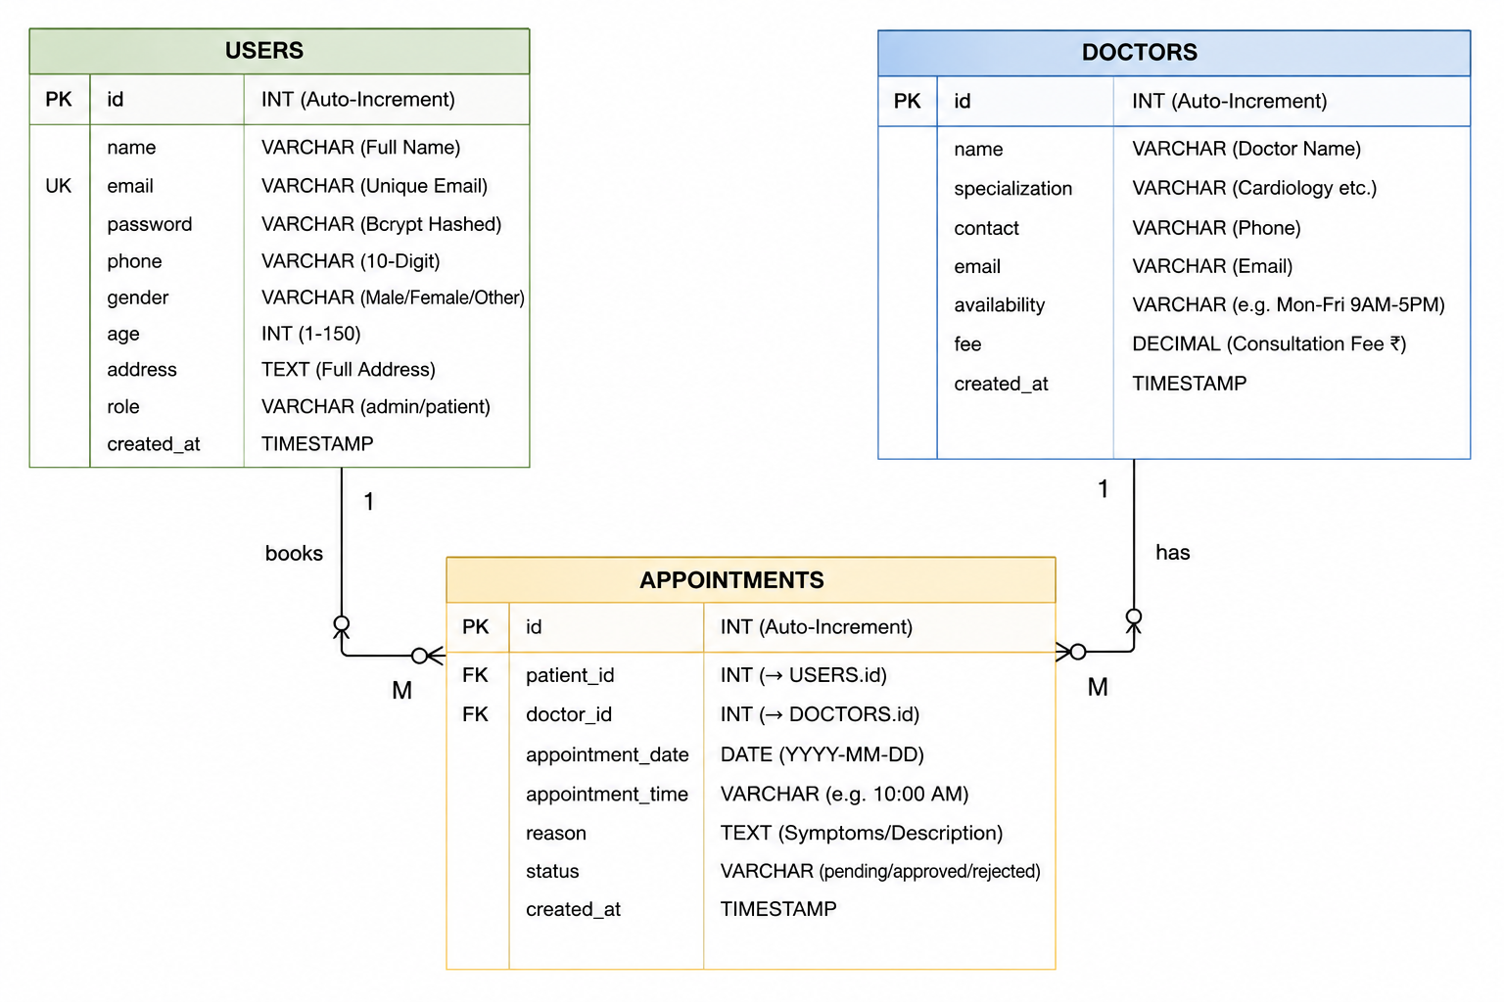
ER Diagram

Slide 12
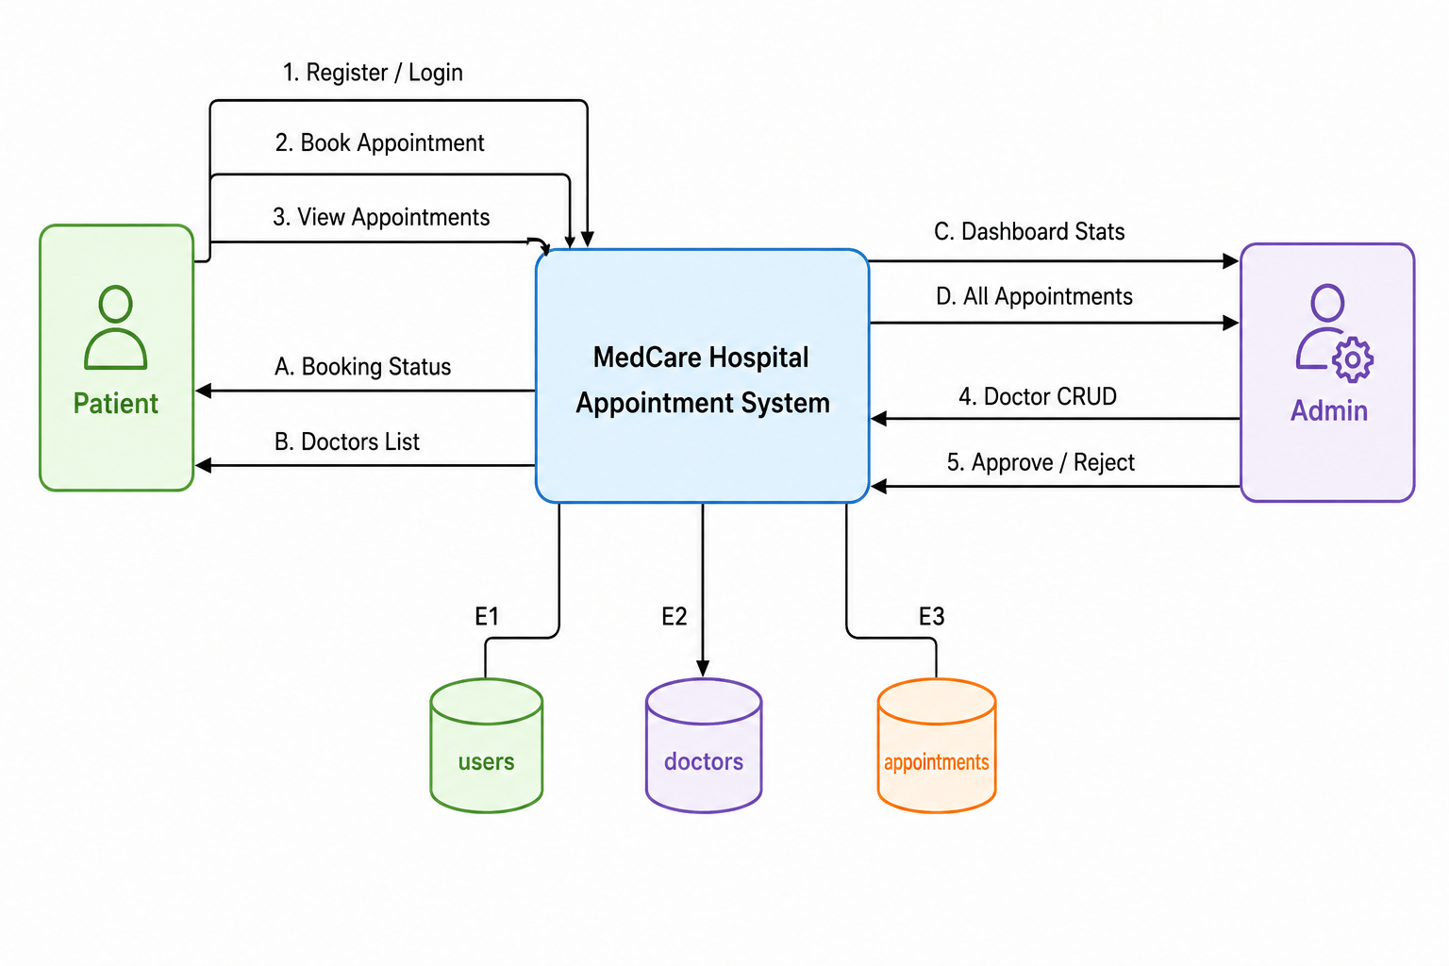
DFD

Slide 13
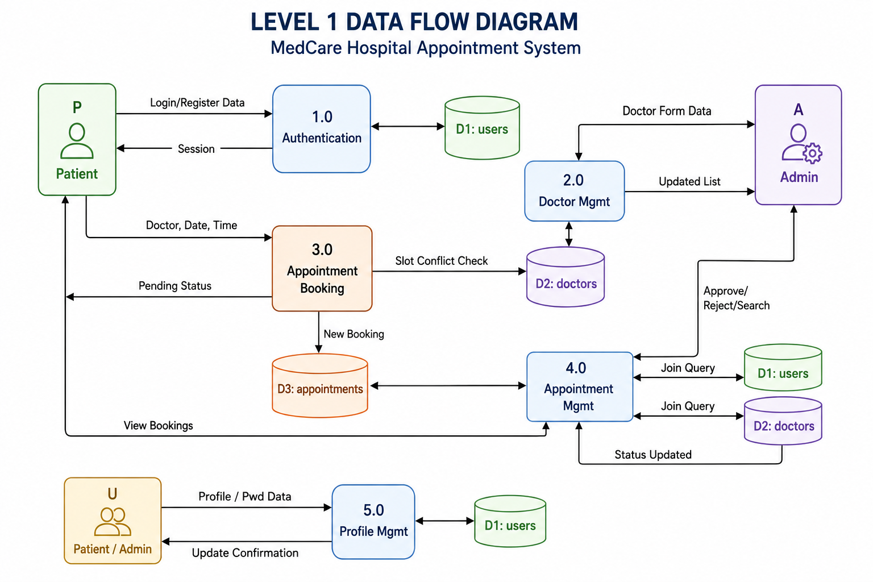

Slide 14
Modules & Features
User Authentication Module
User Management
Doctor Management
Appointment Booking
Profile Management Module

Slide 15
Challenges & Learning
Login Failure Bug
Managing bookings and user roles
Performing CRUD operations efficiently
PHP & MySQL skills

Slide 16
References
PHP Official Documentation
MySQL Documentation
Bootstrap 5 Documentation
YouTube
W3Schools

Slide 17
Thank You

